Slide 1
18-349: Embedded Real-Time Systems Lecture 2: ARM Architecture
Anthony Rowe
Electrical and Computer Engineering
Carnegie Mellon University

Slide 2
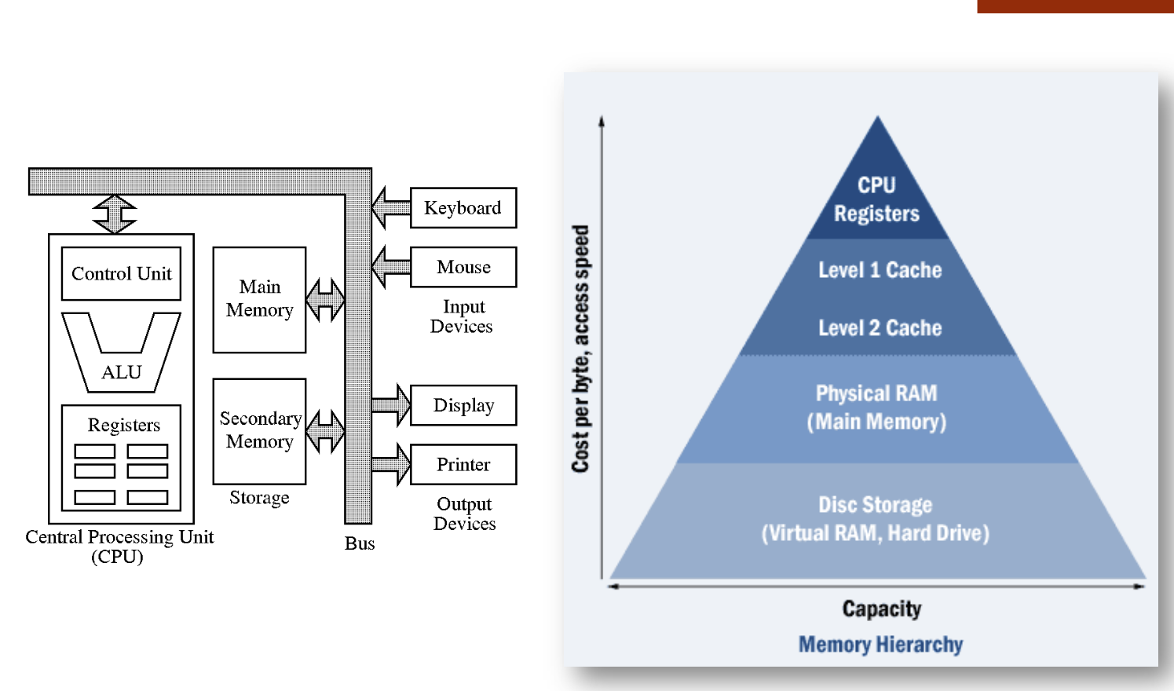
Basic Computer Architecture

Slide 3
Memory Types
DRAM: Dynamic Random Access Memory
Upside: very dense (1 transistor per bit) and cheap
Downside: requires refresh and often slow
Used as main memory
SRAM: Static Random Access Memory
Upside: fast and no refresh required
Downside: not so dense, not so cheap
Often used for caches
EEPROM: Electronically Erasable Programmable Read-only Memory
Used for bootstrapping
Require wear-leveling

Slide 4
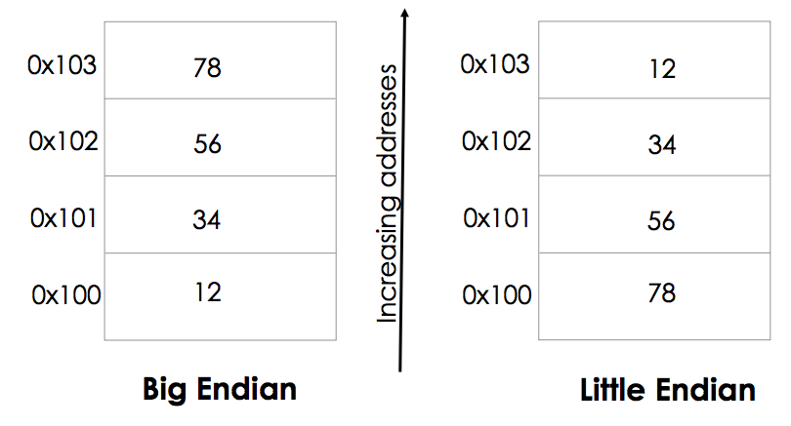
Big Endian vs. Little Endian
How is a word, say, 0x1234567 stored in memory?

Slide 5
Big Endian vs. Little Endian
Big-endian (big end first)
Most significant byte of any multi-byte data field is stored at the lowest memory address
Reading from left to right
SPARC & Motorola
Little-endian (little end first)
Least significant byte of any multi-byte data field is stored at the lowest memory address
Reading from right to left instead
Intel processors
Bi-endian (ARM, PowerPC, Alpha)

Slide 6
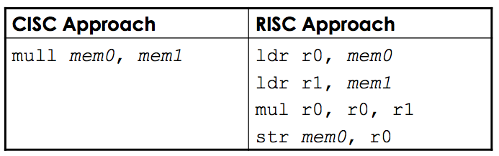
CISC vs. RISC
RISC – Reduced Instruction Set Computers
CISC – Complex Instruction Set Computers
Different architectures for doing the same operations
Suppose you wanted to multiply two numbers in memory locations mem0 & mem1 and store the results back in mem0
Same result but the complexity of operations and the number of steps used in the two cases differ

Slide 7
CISC vs. RISC (1)
CISC | RISC
Example – Intel x86 chips | Examples – SPARC, PowerPC, ARM
Large number of instructions | Few instructions, typically less than 100
Variable-length instructions, instructions can range from 1-15 bytes | Fixed-length instructions, all instructions have the same number of bytes
Some instructions can have long execution times | No instruction with a long execution times execution time

Slide 8
CISC vs. RISC (2)
CISC | RISC
Arithmetic and logical operations can be applied to memory and register operands | Arithmetic and logical operations only use register operands • Memory contents have to be loaded into registers first • Referred to as load/store architecture
Stack-intensive procedure linkage • Stack is used for procedure arguments and return values | Register-intensive procedure linkage • Registers used for procedure arguments and return values

Slide 9
CISC vs. RISC (3)
CISC | RISC
Compact code size is typically small | Compiled code size is larger
More transistors = more power | Fewer transistors = less power

Slide 10
ARM, Ltd.
Founded in November 1990
Spun out of Acorn Computers based in U.K.
ARM was originally Acorn RISC Machine; then, Advanced RISC Machine
Most widely used 32-bit instruction-set architecture in terms of volume
6.1 billion ARM processors in 2010 up to 15 billion in 2015
95% of all smartphones, 35% of digital TVs and set-top boxes
ARM architecture can be licensed, with licensees (former and/or current)
AMD, Apple, Freescale, Microsoft, Nintendo, Xilinx, Qualcomm, TI, etc.
Companies design custom CPU cores with ARM instruction set
Qualcomm’s Snapdragon, Apple’s A8, etc.
ARM Ltd. does not fabricate processors itself
Also develops technologies to help with the design-in of ARM devices
Software tools, boards, debug hardware, application software, buses, peripherals

Slide 11
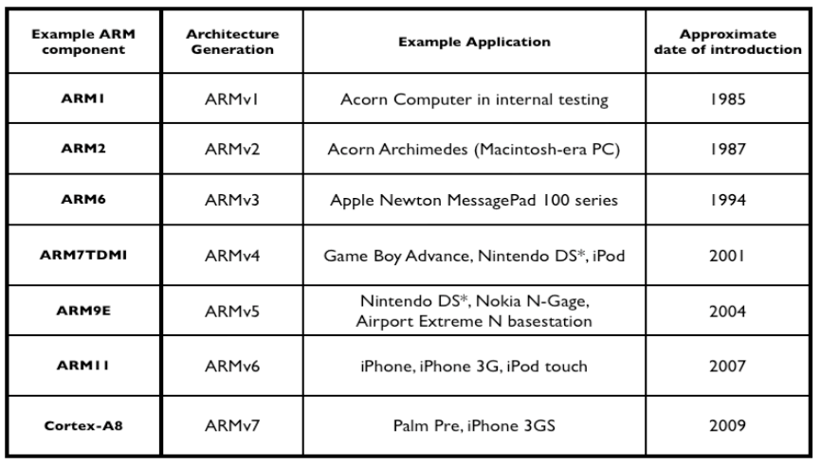
History of ARM’s Usage

Slide 12
SoftBank Acquisition
Japanese multinational company
July 18th 2016
Purchased for £23.4 billion
Speculating on IoT market

Slide 13

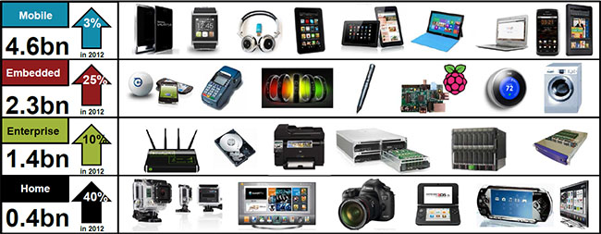
ARM Everywhere

Slide 14
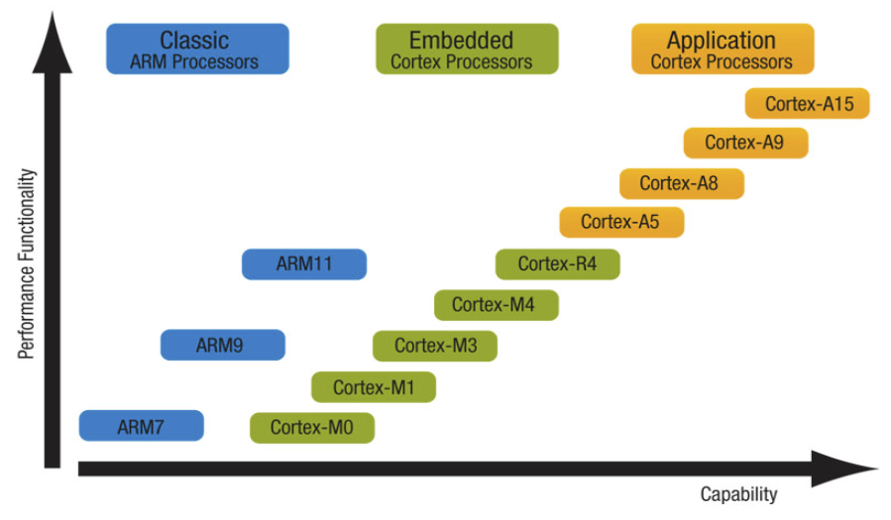
The ARM Family

Slide 15
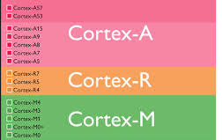
Different ARM Core Families
Cortex-A
Application processors
Single-core or multi-core
Optional multimedia processing
Optional floating-point units
Smartphones, tablets, digital TVs, eBook readers
Cortex-R
Deeply embedded real-time applications
Low power, good interrupt behavior with good performance
Automotive braking systems, printers, storage controllers
Cortex-M
Cost-sensitive microcontrollers
Fast, deterministic interrupt management
Lowest possible power consumption
Automotive airbags, tire-pressure monitoring, smart meters, sensors
Notes:
Deterministic -> Can’t decide when an interrupt will happen, but we can guarantee how long it takes to service it

Slide 16
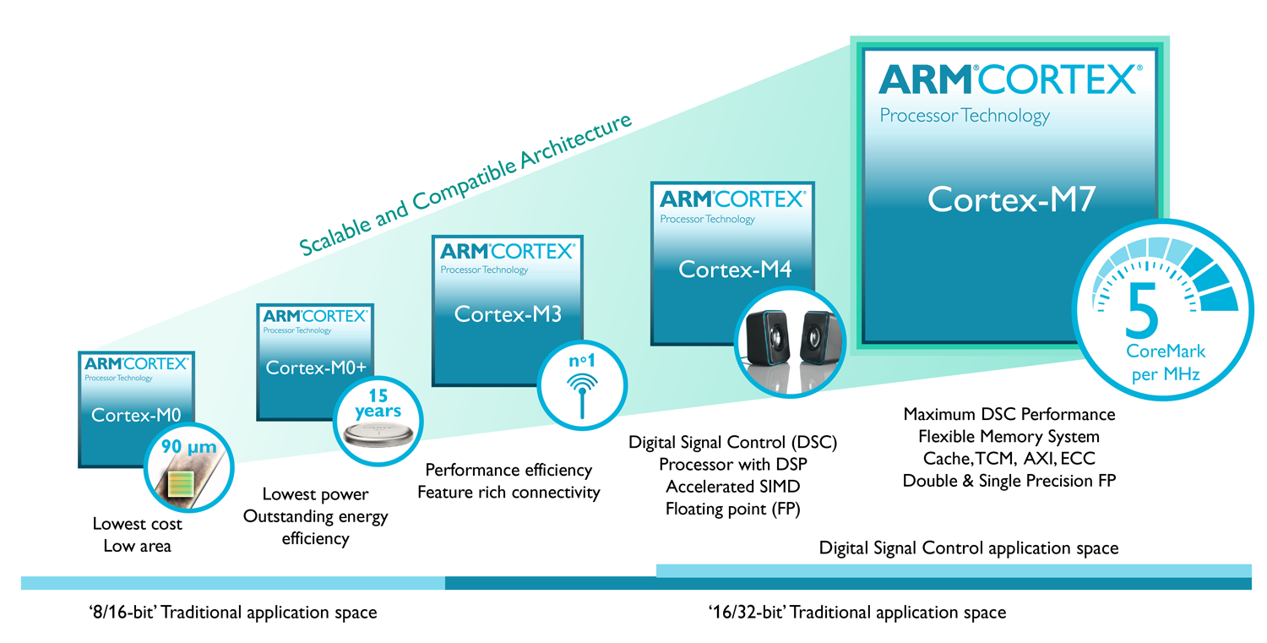
Cortex-M Family

Slide 17
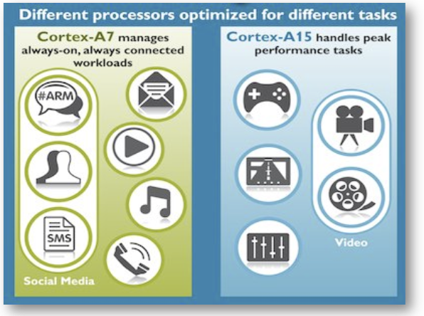
Beyond Cortex
Break?

Slide 18
ARM Data Sizes & Instructions
The ARM is a 32-bit RISC architecture
When used in relation to the ARM
Byte means 8-bits
Halfword means 16 bits (two bytes)
Word means 32 bits (four bytes)
Most ARM processors implement two instructions sets
32-bit ARM Instructions Set
16-bit Thumb Instruction Set
Bi-endian
Can be configured to view words stored in memory as either Big-endian or Little-Endian Format

Slide 19
ARM is a RISC Architecture
A large array of uniform registers
A load/store model, where
Operations operate only on register and not directly on memory
All data must be loaded into registers before being used
Result (in a register) can be further processed or stored to memory
A small number of addressing modes
All load / store addresses are determined from register and isntruction fields
A uniform fixed-length instruction (32-bit)

Slide 20
Programmer’s Model
ARM supports seven processor modes
Characterized by specific behavior, privileges, associated registers
Mode changes can be made under software control, or be caused by external interrupts or exception processing
Most applications execute in User mode
Program cannot access certain protected resources
Program cannot change mode without causing an exception
The 6 modes other then user mode are called privileged modes
5 of these privileged modes are called exception modes
The remaining one is called the System mode (same as User mode, but with access to protected resources)

Slide 21
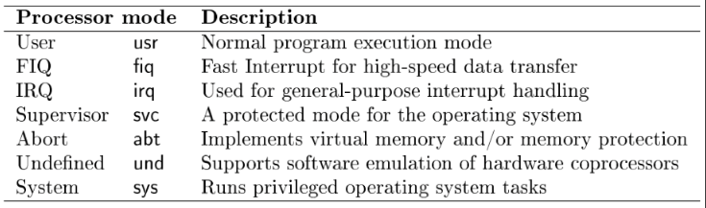
The Seven Modes
Notes:
Supervisor - > “kernel”
Undefined -> Co processor that may undestand the instruction
System -> “root” mode

Slide 22
Register Set (1)
ARM has a total of 37 registers all of which are 32-bit
30 general-purpose registers
1 dedicated program counter (pc)
1 dedicated current program status register (cpsr)
5 dedicated saved program status registers (spsr)
In any mode, only a subset of these 37 registers are visible
The hidden registers are called banked registers
The current processor-mode governs which registers are visible

Slide 23
Register Set (2)
r0 through r7: Eight general-purpose registers that are always available, no matter which mode you’re in (8)
r8 through r12: Five general-purpose registers that are common to all processor modes other than fiq mode (5)
r8_fiq through r12_fiq: Five registers that replace the normal r8-r12 when the processor is in fiq mode (5)
Special-purpose registers
r13 (stack pointer): Same for System and User mode, otherwise, r13_fiq, r13_svc, r13_abt, r13_irq, r13_und (6)
r14 (link register): Same for System and User mode, otherwise, r14_fiq, r14_svc, r14_abt, r14_irq, r14_und (6)
r15 (program counter): A unique one across all modes (1)
Notes:
R14 Link Register -> Keeps track of where you branched from for a conditional

Slide 24
Register Set (3)
Status registers
cpsr (current program status register): Holds current status of processor, including its mode (1)
spsr (saved program status register): Holds processor status information before program changes into an exception mode, r13_fiq, r13_svc, r13_abt, r13_irq, r13_und (5)

Slide 25
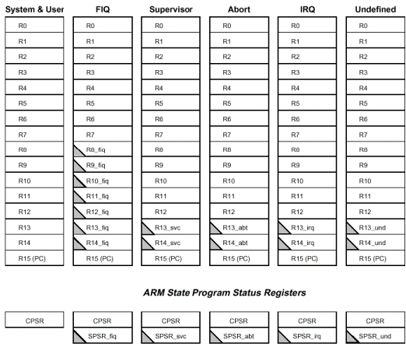
Register Set (4)
1
2
3
4
5
6
7
8
9
14
15
16
17
18
21
22
10
11
12
13
19
20
23
24
25
26
27
28
29
30
31
32
33
34
35
36
37
Notes:
6 different R13 registers

Slide 26
Banked Registers
Banking of registers implies
The specific register depends not only on the number (r0,r1,…,r15) but also on the processor mode
Values stored in banked registers are preserved across mode changes
Example: Assume that the processor is executing in User Mode
In User mode, assume that the processor writes 0 in r0 and 8 in r8
Processor now changes to fiq mode
In FIQ mode, the value of r0 is __________
If processor now overwrites both r0 and r8 with 1 in fiq mode and changes back to user mode
The new value stored in r0 (user mode) is _____________
The new value stored in r8 (user mode) is _____________
Notes:
In FIQ r0 is 0 (not banked)
New r0 is 1 (not banked)
New r8 is 8 (from original)

Slide 27
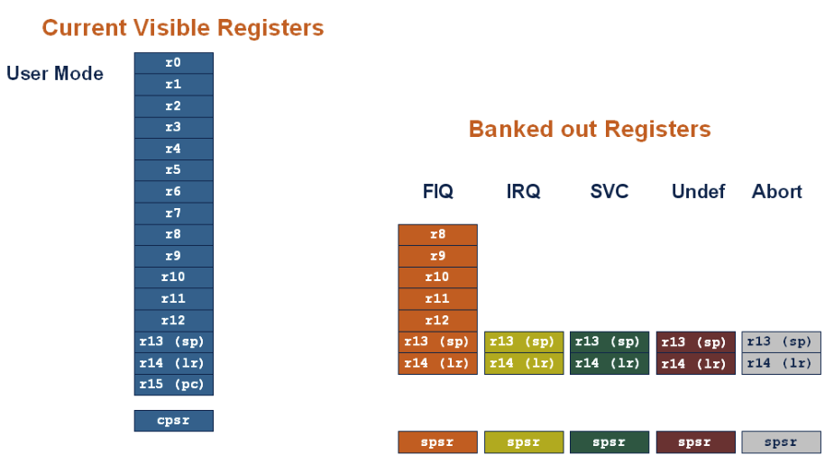
Register Set in User Mode

Slide 28
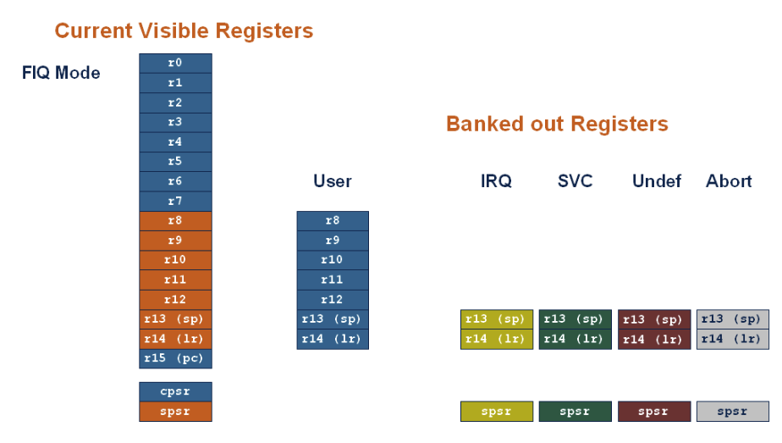
Register Set in fiq Mode
Notes:
FIQ with extra registers to be faster
FIQ is not interruptible

Slide 29
Thumb Mode
Thumb is a 16-bit instruction set
Optimized for code density from C code (~65% of ARM code size)
Improved performance from narrow memory
Subset of the functionality of the ARM instruction set
Core has additional execution state – Thumb
Switch between ARM and Thumb using BX instruction
For most instructions generated by compiler:
Conditional execution is not used
Source and destination registers identical
Only Low registers used
Constants are of limited size
Inline barrel shifter not used

Slide 30
The CPSR (1)
Current Program Status Register (cpsr) is a dedicated register
Holds information about the most recently performed ALU operations
Controls the enabling and disabling of interrupts (both IRQ and FIQ)
Sets the processor operating mode
Sets the processor state

Slide 31
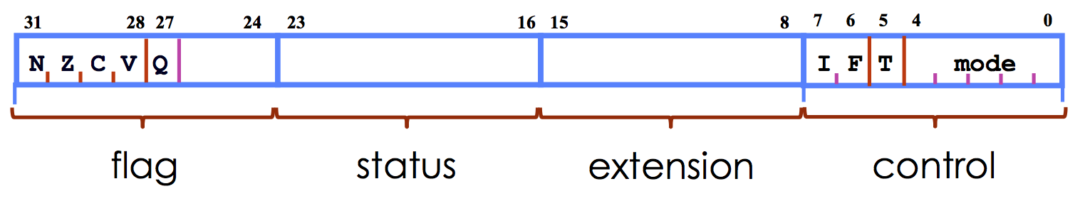
The CPSR (2)
cpsr has two important pieces of information
Flags: contains the condition flags
Control: contains the processor mode, state and interrupt mask bits
All fields of the cpsr can be read/written in privileged modes
Only the flag field of cpsr can be written in User mode, all fields can be read in User mode

Slide 32
The CPSR (3)
Interrupt Disable bits
I = 1: Disables IRQ
F = 1: Disables FIQ
T Bit
T = 0: Processor in ARM state
T = 1: Processor in Thumb state
Mode bits
Specify the processor mode
When exceptions occur cpsr gets copied to the corresponding spsr_<mode> register for storage

Slide 33
The CPSR (4)
Will represent this as nzcvqift_mode
Upper case letters will indicate that a certain bit has ben set
Examples
nzcvqiFt_USER: FIQs are masked and the processor is executing in user mode
nzCvqift_SVC: Carry flag is set and the processor is executing in supervisor mode
Notes:
N – negative
Z – Zero
C – Carry
V - Overflow

Slide 34
Exceptions vs. Interrupts
Term exception and interrupt are often confused!
Exception usually refers to an internal CPU event such as
Floating point overflow
MMU fault (e.g., page fault)
Trap (SWI)
Interrupt usually refers to an external I/O event such as
I/O device request
Reset
In the ARM architecture manuals, the two terms are mixed together and are considered interchangeable

Slide 35
ARM Exceptions
Exception | Mode | Description
Reset | Supervisor | Occurs when the processor􏰀s reset button is asserted. This exception is only expected to occur for signaling power up or for resetting the processor. A soft reset can be achieved by branching to reset vector 0x00000000 or letting the watchdog timer expire
Undefined Instruction | Undef | Occurs if neither the processor, nor any of the coprocessors, recognize the currently executing instruction
Software Interrupt | Supervisor | This is a user-defined synchronous interrupt. It allows a program running in the User mode to request privileged operations (for example an RTOS function) that run in Supervisor mode
Prefetch Abort | Abort | Occurs when a processor attempts to execute an instruction that was not fetched, because the address was illegal
Data Abort | Abort | Occurs when a data transfer instruction attempts to load or store data at an illegal address
IRQ | IRQ | Occurs when the processor􏰀s external interrupt request pin is asserted and the I bit in the cpsr is clear
FIQ | FIQ | Occurs when the processor􏰀s external fast interrupt request pin is asserted and the I (F-bit???) bit in the cpsr is clear

Slide 36
ARM Exception Handling (1)
Exception Handler
Most exceptions have an associated software exception handler that executes when that particular exception occurs
Exception modes and registers
Handling exceptions changes program from user to non-user mode
Each exception handler has access to its own set of registers
Its own r13 (stack pointer)
Its own r14 (link register)
Its own spsr (Saved Program Status Register)
Exception handlers must save (restore) other registers on entry (exit)

Slide 37
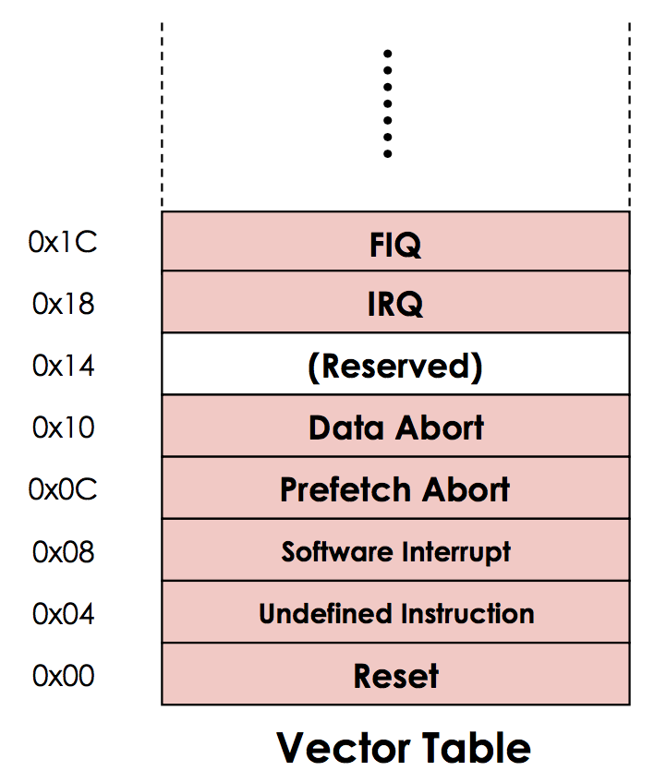
ARM Exception Handling (2)
Where is the is exception handler located?
Vector table
Reserved area of 32 bytes at the end of the memory map (starting at address 0x0)
One word of space for each exception type
Contains a Branch or Load PC instruction for the exception handler

Slide 38
ARM Exception Handling (3)
When an exception occurs, the ARM processor:
Copies cpsr into spsr_<mode>
Sets appropriate cpsr bits
Change to ARM state
Change to exception mode
Disable interrupts (if appropriate)
Stores the return address in lr_<mode>
Sets pc to vector address
To return, exception handler needs to:
Restore cpsr from the spsr_<mode>
Restore pc from lr_<mode>

Slide 39
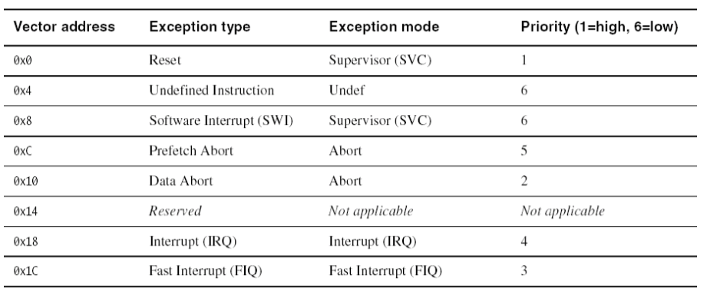
Simultaneous Exceptions?

Slide 40
Why Exceptions?
Functionality that would otherwise not be possible
Memory or Data Abort can be used to implement Virtual Memory
SWI allows for system calls
Undefined exceptions can be used to provide software emulation of coprocessor when the coprocessor is not physically present or could be used for special purpose instruction set extensions
If an unknown instruction is reached the processor changes to Undefined mode and executes the Undefined Instruction exception handler
In the exception handler, the coprocessor functionality can be provided in software (or the functionality provided by the enhanced instrucionts can be provided in software)

Slide 41
Summary
What is an ARM?
CISC vs RISC
ARM family
Memory
ARM Architecture from a programmer’s viewpoint
Processor modes
General purpose registers
Special purpose registers
Exception handling
Next Time: Deeper into ARM ASM

